Slide 1
Data Science and Machine Learning
Module 5, Lesson 1:
Introduction to Data Science and Machine Learning

Slide 2
Topics
What is Data Science?
What is Machine Learning?

Slide 3
Objectives
By the end of this lesson you should understand:
The basics of data science
Machine learning basics
Machine learning feature representation and modeling

Slide 4
What is Data Science?
Data science is using data to make decisions that drive actions
Data science is the exploration and quantitative analysis of all available structured and unstructured data.
Notes:
Notes:
Data science is used to develop understanding, extract knowledge, and formulate actionable results.
Reference:
Microsoft: DATA203x Data Science and Machine Learning Essentials, edx.org

Slide 5
Predictive vs. Preemptive Analytics
Predictive Analytics
Preemptive Analysis
Learns from the past
Looks at past data and designs statistical models or machine learning models to predict the future
Takes actions based on the past
Takes those predictions about the future and turns them into actions or policies

Slide 6
Evolution of Data Science
Data
What should I do?
Decisions
Actions
What will happen?
Why did it happen?
What happened?
Manual process
Notes:
Notes:
Data science is evolving from simply trying to figure out what happened in the past to
Going deeper and discovering why it happened to
Predicting the future and figuring out what will happen
The final goal it to not only figure out what will happen but to make decisions preemptively and take actions automatically
References:
Microsoft: DATA203x Data Science and Machine Learning Essentials, edx.org

Slide 7
Who Performs Data Analytics?
Domain Expertise
Data science is a multi-disciplinary activity
Data
Science
Code/Computing Expertise
Math/Statistics
Notes:
Notes:
Rarely would one person have all of this expertise.
Data science requires collaboration between experts in each discipline.
Reference:
BerkeleyX: CS100.1x Introduction to Big Data with Apache Spark, edx.org

Slide 8
High Demand for Data Scientist
The sexiest job of the 21th Century
Median salary of a junior level data scientist is $91K
When changing jobs, data scientist see a 16 percent increase in their median base salary
McKinsey projects that “by 2018, the U.S. alone may face a 50 percent to 60 percent gap between supply and requisite demand of deep analytic talent”
Notes:
References:
http://www.forbes.com/sites/gilpress/2015/04/30/the-supply-and-demand-of-data-scientists-what-the-surveys-say/#1a7305f7205e

Slide 9
A Tale of Two Cities
It was the best of times, it was the worst of times
Data scientists automated and unemployed by 2025
Automated predictive analytics
Notes:
Notes:
Many knowledge based jobs are becoming automated. This is no exception for data scientist. In some ways, it is ironic in that they will be creating the very tools to cause the decline of their jobs
References:
http://www.datasciencecentral.com/profiles/blogs/data-scientists-automated-and-unemployed-by-2025
http://www.kdnuggets.com/2015/05/data-scientists-automated-2025.html

Slide 10
Basic Steps to Data Science
Extracting value from large amounts of data is the challenge of data science
Find the data
Extract and acquire the data
Clean and transform the data
Understand the relationships in the data and build a model
Data mining
Evaluate and refine the model
Communicate the results

Slide 11
The Data in Data Science
How does the data in data science differ from traditional databases?
Database
Modest
Limited
Structured schema data
Very valuable
Data Volume
Data Growth
Data Type
Data Value
Data Science
Massive Volume
Very fast
Variety of structured and unstructured
Cheap and replaceable
Notes:
Notes:
A very critical driver to current data science is Big Data and the 3Vs of Big Data
Volume
Variety
Velocity
In a database, each data point is very valuable.
In data science, however, massive amounts of data are analyzed.
Inevitably, there will be missing data and outright, incorrect data.

Slide 12
Cleaning the Data
Garbage In = Garbage Out
Some dirt in = Statistically cleansed
Data Validation includes:
Data-type constraints
Range constraints
Non-null constraints
Unique key
Set member constraints
Notes:
Notes:
Data-type constraints ask if data fits the correct data type.
Range constraints check to see if the data fit the appropriate range.
Non-null constraints ensure that fields that cannot be null include data.
Some fields, such as primary keys, must be unique in the set.
Set member constraints ensure that only specific sets of choices are made available (i.e., Yes, No, N/A).
References:
https://en.wikipedia.org/wiki/Data_cleansing

Slide 13
Cleaning the Data
Matching multiple datasets:
Datasets | Description
Primary-Foreign Key | Unlike databases, primary and foreign key matches may be missing and have to be created
Inconsistent Format | Some data may have (xxx) xxx-xxxx while others have xxx-xxx-xxxx
Inconsistent Entry | The data may have been entered differently: Somestreet Street or Somestreet St.
Notes:
Notes:
When datasets come from multiple sources or possibly from semi-structured or even unstructured sources, you may have issues with matching the relationship between the datasets as would be possible in a relational database with a primary and foreign key match up

Slide 14
Big Data Processing

Slide 15
Challenges of Big Data
The 3 Vs of Big Data
Volume
Velocity
Variety
Volume
Velocity
Variety
Notes:
Notes:
The sheer volume of data being generated is reaching petabyte levels in some cases.
This accumulation is not slowing down but rather speeding up.
There is a growing number of data sources including the web, mobile, and sensor data (IoT).

Slide 16
Computer vs. Data
Moore’s Law vs. Data Deluge
Moore’s Law states that computing power will double every 18 months
Data Deluge:
Data is now doubling every 12 months.
According to IBM, build out of IoT will double data every 12 hours
Notes:
Notes:
The prediction of Moore’s Law has been very accurate for the last few decades.
Until 1900s human knowledge doubled every century.
By end of WWII, human knowledge was doubling every 25 years.
Reference:
http://www.industrytap.com/knowledge-doubling-every-12-months-soon-to-be-every-12-hours/3950

Slide 17
Cluster Computing
Big Data problems must be solved with cluster computing
Cluster computing allows organizations to:
Throw more hardware at the problem
Use cheap commodity-grade hardware instead of expensive servers
Space per unit cost of storage has doubled roughly every 14 months
Move data to where the computing is to reduce network latency
Notes:
Notes:
Computing power can not keep up so only way to solve.
Adding commodity-grade hardware allows clusters to be scaled out instead of scaling up.
Scale Up: uses better and more expensive hardware
Scale out: uses more hardware
Moving data to where computing power is reduces network latency.
Reference: http://www.mkomo.com/cost-per-gigabyte

Slide 18
Fault Tolerance and Performance
Use of low-cost commodity hardware for fault tolerance and performance
Improved hardware failure statistics
Complexity to solve the problem is moved to the software
Notes:
Notes:
Google’s hardware failure experience:
1~5% of hard drives per year
0.2% of DIMMs (dual in-line memory modules) per year
Software for fault tolerance and performance:
Hadoop – HDFS
Map Reduce
Reference:
http://www.datacenterknowledge.com/archives/2008/05/30/failure-rates-in-google-data-centers/

Slide 19
Hadoop Map-Reduce Stage
A map-reduce process reads and writes to disk
Map
Reduce
Map
Reduce
Map
Reduce
Notes:
Notes:
Mappers read data from disk and perform computation.
After all the mappers have completed, the data is shuffled, sorted, and written to disk.
The reducers read the data, perform the reduction, and write the results to disk.

Slide 20
Distributed Computation
A job often involves many map-reduce stages
Map-Reduce Stage 1
Map-Reduce Stage 2
Map-Reduce Stage 3
Notes:
Notes:
In each of map-reduce stage, the disk reads and writes between the mapper and the reducer.
In between the stages, each of the immediate results is written to disk and read back by the next stage.
Disk I/O is very expensive.

Slide 21
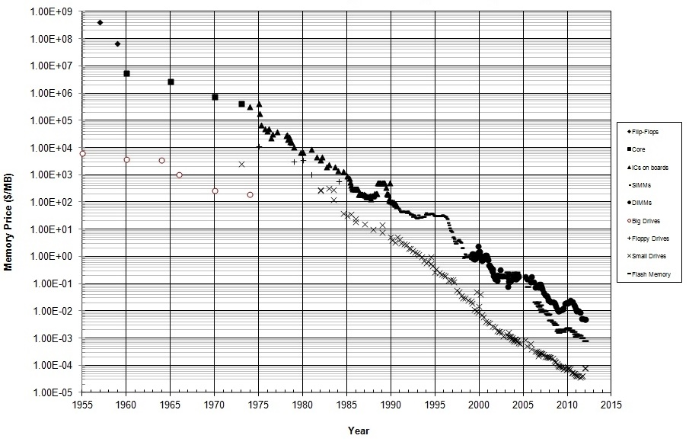
Historical Cost of Memory & Storage
Notes:
Notes:
This is a logarithmic scale.
Both memory and disk costs have been dropping exponentially.
In 2010, memory cost roughly 1 cent per megabyte of memory and 1 cent per 100 MB of storage.
Reference: http://datarep.tumblr.com/post/60074240896/historical-cost-of-computer-memory-and-storage

Slide 22
Changing Hardware - Opportunity
Size of both memory and disk are increasing
Typical commodity hardware now has:
Terabytes of hard drive
Gigabytes of memory space
Multi-core processors
Lower hard disk cost has not translated to faster hard disks:
Each terabyte of hard disk now costs about $30
Time to read a terabyte still takes about 3 hours (100MB/s)

Slide 23
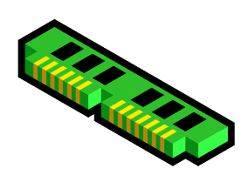
Distributed Computation – In Memory
Read and write to memory instead of hard disk
Map -Reduce Stage 1
Map-Reduce Stage 2
Map Reduce Stage 3
Map-Reduce Stage 1
Map-Reduce Stage 2
Map-Reduce Stage 3
Notes:
Notes:
Perform Disk I/O only at the beginning of computation to load the data into memory.
Distribute the data over all the memory resources in the cluster.
Typically 10~100 times faster.

Slide 24
A Case for Spark
Spark is gaining momentum as de facto heir to MapReduce
Higher level programming Paradigm
Pages of code in Java MapReduce
Lines of code in Python pySpark
10~100 fold performance gain
In-memory computation

Slide 25
Machine Learning Overview
Machine learning is a computing technique
Origins of machine learning are in artificial intelligence (AI) and statistics.
Machine learning includes:
Classification
Regression
Clustering
Recommendation
Notes:
Notes:
Classification: Predicting a binary or Boolean value for an entity with a given set of features.
Regression: Predicting a real numeric value for an entity with a given set of features
Clustering: Grouping entities with similar features.
Recommendation: Recommending an item to a user based on past behavior or preferences of similar users.
References:
Microsoft: DATA203x Data Science and Machine Learning Essentials, edx.org

Slide 26
Machine Learning Method- Supervised
Supervised Learning
Machine learning uses ground truth observations to:
Learn from a set of training data
“Teach” the algorithm to learn the mapping
Notes:
Notes:
“Ground truth” refers to information provided by direct observation.

Slide 27
Machine Learning Method- Unsupervised
Unsupervised Learning
Learning from unlabeled observations
The learning algorithm must discover latent patterns and structure
In the features along
Sometimes, this can be a goal in of itself:
Exploratory data analysis
Discovery of hidden patterns

Slide 28
Supervised Learning Pipeline
Find and acquire raw data
Represent the Features
Supervised Learning
Evaluate the model
Use model for
predictive analysis
Notes:
Notes:
Initial data will typically not be in the correct format.
Features are extracted to represent observations. Domain expertise is very important for this step.
A supervised model is then trained for classification or regression using labeled ground truth observations.
The model is run on the test data to see how it performs.
If necessary, iterations are performed.
Once feature representation and model are acceptable, model is used to analyze other data sets.

Slide 29

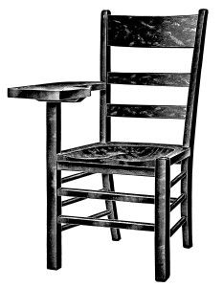


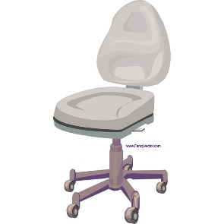





Machine Learning - Classification
Labeled Training Set
Test Set
Chair ?
chair
Not chair
Not chair
Not chair
Not chair
chair
Notes:
Notes:
Classification algorithms answer a binary question: generally yes/no.
Algorithm is provided with a training set labeled with ground truth observations.
Notice that the labels are “chair” or “not chair”; i.e., they are not labeled dog, car, etc.
Alternatively, items could be labeled with the specific names and the algorithm would simply convert these to “not chair”.
Notice that one item is really a chair but labeled incorrectly as “not chair”.
Data can have noise and errors, however, a small amount will not affect the overall effectiveness of the algorithm.
After running the machine-learning algorithm on the labeled training set, it must then be run on the test set to determine how accurate the algorithm is.

Slide 30

Feature Vectorization
Each observation is represented by a set of numbers.
Each pixel has a RGB value like [1.0, 1.1, 0.8]
Entire image is represented as [1.0, 1.1, 0.8, ………….]
Label = -1 or false (i.e., this image is not a chair)
Notes:
Notes:
Features must be represented by numbers in order to run the algorithm

Slide 31
The Importance of Good Representation
Choosing the optimal feature representation is a key step
Choosing the right representation is often a trade off:
Simpler representations (i.e. smaller vectors) are easier to compute
Oversimplification will lead to loss of features
Notes:
Notes:
In the previous slide, the case of representing images by raw RGB data was presented.
Only the most simple image classification will work with such a simple model.

Slide 32
Weather Prediction Example
Will it rain tomorrow?
First step is to represent the features numerically
Then determine feature representation and trade-offs
Notes:
Notes:
Some sources of data:
Current sensor data
Historical data
Somewhere in between (i.e., yesterday’s sensor data, perhaps past 1 week)
Geographically, how wide of a range of sensors should be considered?
How far back, historically, should the data be examined?
Some data may be real, such as percentages.
Some data may be Boolean such as yes or no.

Slide 33
Weather Prediction Example (cont.)
Will it rain tomorrow?
Modeling the feature representation
Use data modeling to create predictive model
Determine combination of features that will give the best predictor
Notes:
Notes:
How are features combined together to form a predictive model?
Features could be added together, but this will most likely not be very accurate.
Features could be weighted and then added together, but how would weights be determined?

Slide 34
Weather Prediction Example (cont.)
Will it rain tomorrow?
Weight sums to model predictor require determination of weights
Machine learning can provide weighting for features
Data modeling:
Algorithm is run on the test data set.
Machine-learning algorithm will generate weights for each feature
Notes:
Notes:
Remember, this is a supervised learning mode, where the ground truth observation is available – i.e., did it rain or not?

Slide 35
Cortana Intelligence Suite
An integrated suite of big data and advanced analytics and APIs
Information Management
Big Data stores
Machine learning and advanced analytics
Dashboards and visualization
Cognitive Services
Notes:
Notes:
Information Management: tools to manage the acquisition, orchestration and ingestion of data
Big Data Stores: Data lakes, Blobs, Elastic Storage
ML and Advance Analytics: Visual tools and suite of algorithms for machine learning and advanced analytics, stream analytics
Dashboards and Visualization:
Cognitive Services: A suite of API’s for Vision (face recognition, emotion recognition), Speech (speaker recognition,, speech recognition), Linguistics (text analytics), etc
Tools make doing advanced analytics / predictive analytics very easy and practical.
As these types of tools develop, the demand for “data scientists” may dwindle
References:
https://www.microsoft.com/en-us/cloud-platform/cortana-intelligence-suite

Slide 36
Summary
In this lesson, you have learned:
The basics of Data Science
How data science is evolving
Machine learning basics
ML feature representation and modeling

